Slide 1
64060 final project
Mo Zhang

Slide 2

Problem and goal
1.Usage of k-means clustering to identify what influences house price and which properties can be grouped together?
2.Basic understanding of house details of Washington.
3. how to better recommend a house to customers?

Slide 3
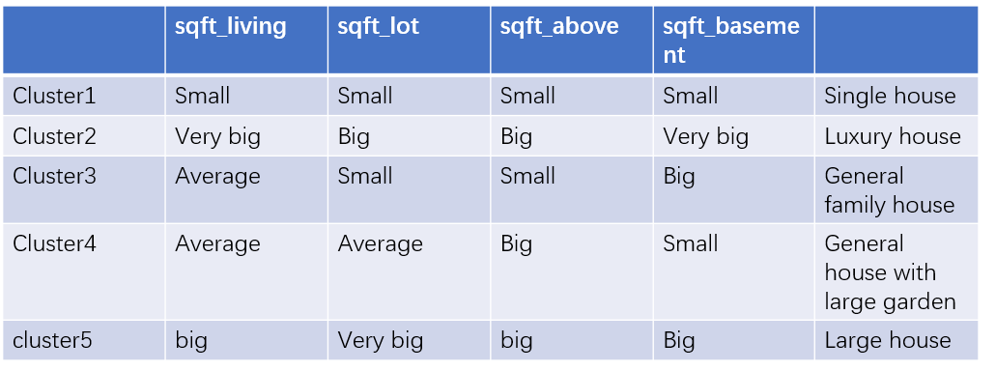
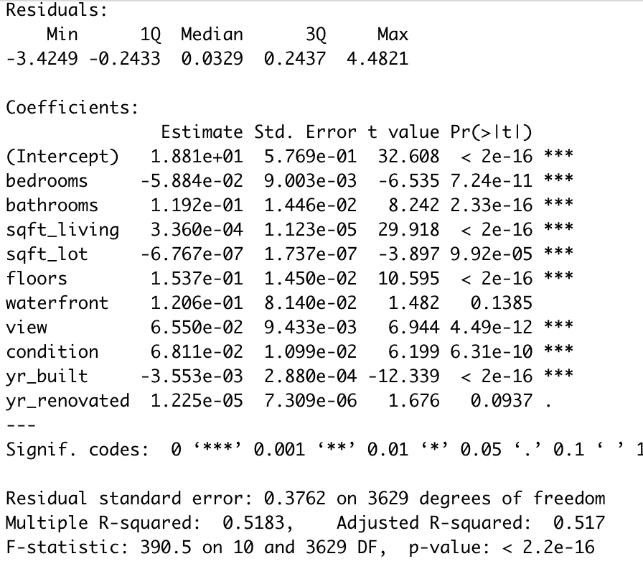
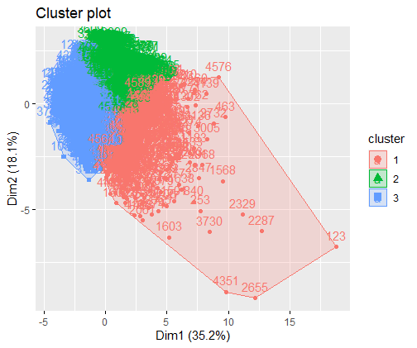
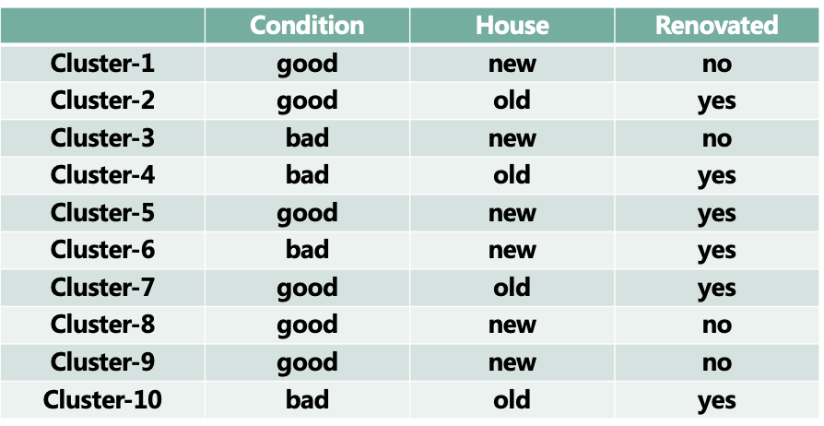
Cluster1-Use Kmeans to cluster house sqft (sqft_living + sqft_lot + sqft_above + sqft_basement)
Cluster2-Use kmeans to cluster house condition (condition + yr_built + yr_renovated)
Cluster3-Use liner + kmeans to cluster(price+bedrooms+bathrooms+sqft_living + sqft_lot + sqft_above + sqft_basement+ condition + yr_built+floor+view)

Slide 4

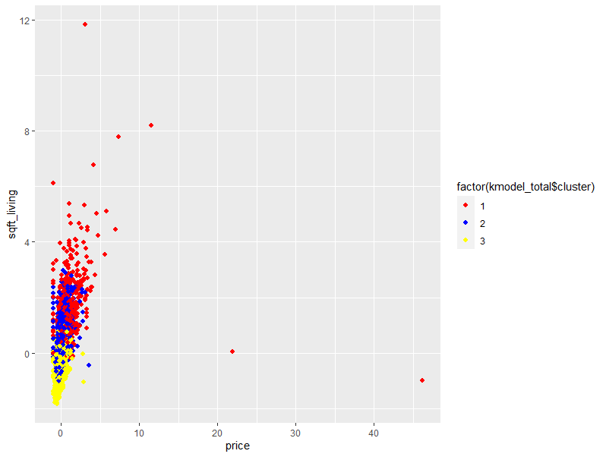
Conclusion and Future Deployment
1. Knowing the distribution of houses in different cities, help customers with different needs.
2.Classifying houses, offering different houses for different kinds of guests.
3. Analyze customer preferences and what characteristics of the house type will be more popular with customers.
4. Understand the main factors affecting house prices and get a reasonable explanation from the perspective of the market and economics.

